Slide 1

SUPERSTORE SALES PERFORMANCE ANALYSIS
Beginner-Level Data Analytics Internship Project
  Submitted by: Nitu Singh
  College: Siddhartha Women's Degree College
  University: Osmania University
  Company: ShadowFox
  Role: Data Analyst Intern
  Internship Duration: 1st october-31st october
  Mentor/Coordinator: Mr.Aakash
Tools Used: Microsoft Excel, PivotTables, PivotCharts, KPI Analysis and Interactive Dashboard

Slide 2
ACKNOWLEDGEMENT
  I would like to express my sincere gratitude to ShadowFox for providing me with the opportunity to work on this beginner-level data analytics project.
  I extend my thanks to my mentor and coordinators, including Mr. Aakash, for their guidance and support throughout this learning experience.
  This project was completed through my own practical work and analysis, with the help of relevant reference materials and ChatGPT for generating ideas and clarifying concepts.
  This experience helped me understand how data analysis and visualization can transform raw business data into meaningful insights.

Slide 3
BEGINNER LEVEL: PROJECT OVERVIEW
  Task: Superstore Sales Performance Analysis Using Microsoft Excel
Objective
To analyze retail sales data, understand business performance, identify profitability patterns, and present useful insights through an interactive Excel dashboard.
Dataset Overview
  Approximately 51,290 transaction records across 21 columns.
  Data period: 2011–2014.
  Key fields: Sales, Profit, Quantity, Discount, Shipping Cost, Category, Subcategory, Region, Market, Customer Segment, and Order Date.
Tasks Performed
  Reviewed the dataset and checked for duplicate records and obvious data-quality issues.
  Created KPI calculations and PivotTables.
  Analyzed sales and profit across different business dimensions.
  Created PivotCharts and an interactive Year slicer.
  Developed an Excel dashboard and prepared business recommendations.
Tools: Microsoft Excel, PivotTables, PivotCharts, formulas and charts.

Slide 4
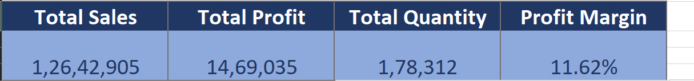
KPI ANALYSIS
Key Performance Indicators
The dashboard uses four KPIs to summarize the overall performance of the Superstore dataset.
1. Total Sales — 12,642,905
Measures the total sales value generated across the dataset.
2. Total Profit — 1,469,035
Measures the overall profit generated from the analyzed transactions.
3. Total Quantity — 178,312
Represents the total quantity of items sold.
4. Profit Margin — 11.62%
Calculated as Total Profit divided by Total Sales, multiplied by 100.
Business Understanding:
These KPIs provide a quick overview of sales volume and profitability. Comparing sales with profit helps evaluate whether revenue generation is translating into business returns.

Slide 5
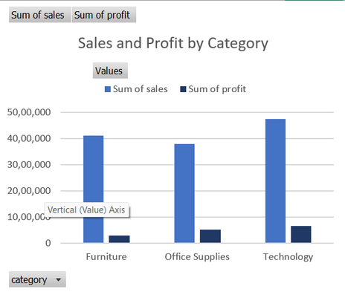
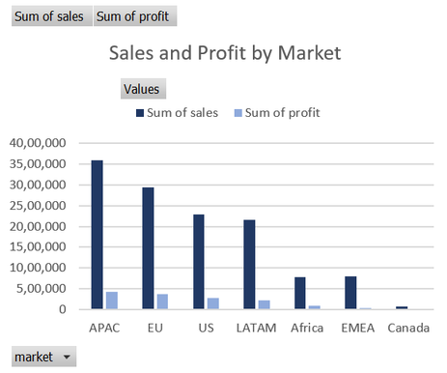
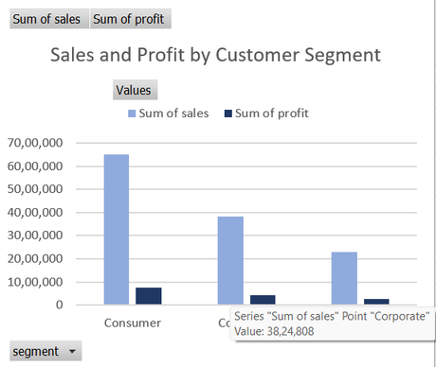
UNDERSTANDING SALES AND PROFIT ACROSS BUSINESS DIMENSIONS
Chart 1: Sales and Profit by Category
Chart used: Comparative chart showing sales and profit by product category.
Purpose: To compare the contribution of Furniture, Office Supplies and Technology to overall sales and profit.
What I learned:
  Technology generated the highest sales, at approximately 4,744,691, and the highest profit, at approximately 663,779.
  Furniture generated sales of approximately 4,110,884 but profit of approximately 286,782.
  Office Supplies generated approximately 3,787,330 in sales and 518,474 in profit.
Business insight: High sales do not always translate into proportionately high profit. Furniture's profitability deserves further investigation.
Chart 2: Sales and Profit by Market
Chart used: Comparative chart showing sales and profit across markets.
Purpose: To understand which markets contribute most to the business.
What I learned:
  APAC generated approximately 3,585,833 in sales and 437,578 in profit.
  EU generated approximately 2,938,139 in sales and 372,830 in profit.
  The US generated approximately 2,297,354 in sales and 286,397 in profit.
Business insight: APAC leads the analyzed markets in both sales and profit. Market-level performance can help management prioritize further investigation and planning.
Chart 3: Sales and Profit by Customer Segment
Chart used: Comparative chart by Consumer, Corporate and Home Office segments.
Purpose: To understand which customer segments contribute most to sales and profit.
What I learned:
  Consumer generated approximately 6,508,141 in sales and 749,240 in profit.
  Corporate generated approximately 3,824,808 in sales and 442,786 in profit.
  Home Office generated approximately 2,309,956 in sales and 277,009 in profit.
Business insight: Consumer is the largest segment by both sales and profit in this dataset.

Slide 6
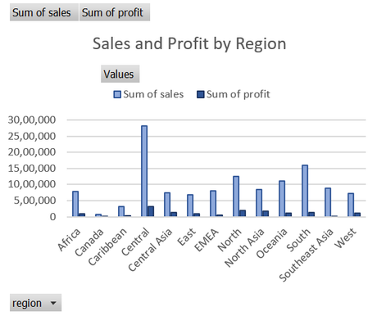
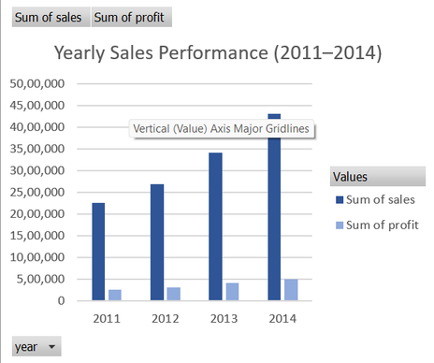
IDENTIFYING GEOGRAPHIC AND SALES TRENDS
Chart 4: Sales and Profit by Region
Chart used: Comparative chart showing sales and profit by region.
Purpose: To compare business performance across geographic regions.
What I learned:
  Central recorded the highest sales among the listed regions, at approximately 2,822,399, and profit of approximately 311,404.
  South generated approximately 1,600,960 in sales and 140,356 in profit.
  North generated approximately 1,248,192 in sales and 194,598 in profit.
Business insight: Regional sales and profitability should be evaluated together to identify opportunities and areas requiring further analysis.
Chart 5: Yearly Sales Performance
Chart used: Comparative column chart showing yearly sales and profit.
Purpose: To compare business performance across 2011, 2012, 2013 and 2014.
What I learned:
  2011 sales: approximately 2,259,511.
  2012 sales: approximately 2,677,493.
  2013 sales: approximately 3,405,860.
  2014 sales: approximately 4,300,041.
Business insight: Sales increased every year in the analyzed period, indicating a sustained upward trend in the dataset.

Slide 7
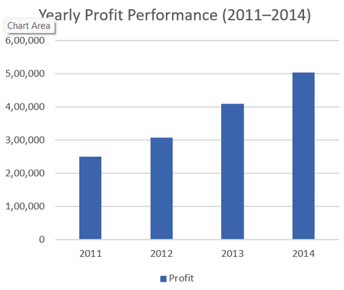
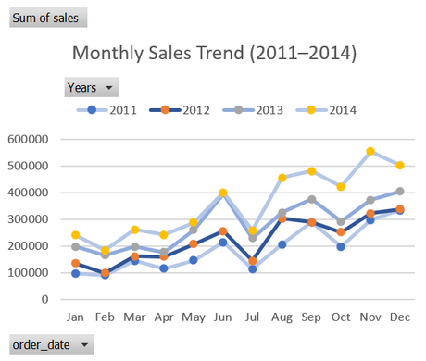
IDENTIFYING GEOGRAPHIC AND SALES TRENDS
Chart 6: Yearly Profit Performance
Chart used: Column chart showing yearly profit.
Purpose: To examine whether profitability increased alongside sales.
What I learned:
  2011 profit: approximately 248,941.
  2012 profit: approximately 307,415.
  2013 profit: approximately 408,513.
  2014 profit: approximately 504,166.
Business insight: Total profit also increased each year. Monitoring both sales and profit provides a more complete picture than sales alone.
Chart 7: Monthly Sales Trend
Chart used: Line chart with four lines representing 2011–2014.
Purpose: To compare monthly sales patterns across the four years.
What I learned:
  The chart allows month-by-month comparison across years.
  November and December show relatively high combined sales in the dataset.
  Monthly sales patterns can help support inventory and promotional planning.
Business insight: Historical monthly patterns can inform planning, but additional analysis is needed before concluding why particular months perform better.

Slide 8
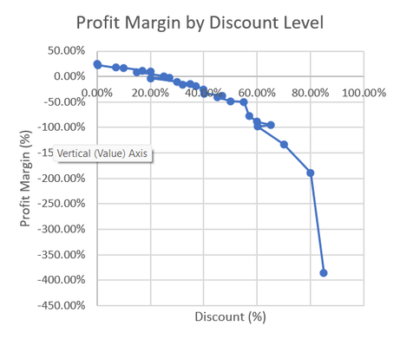
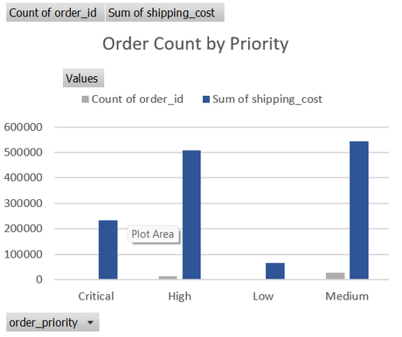
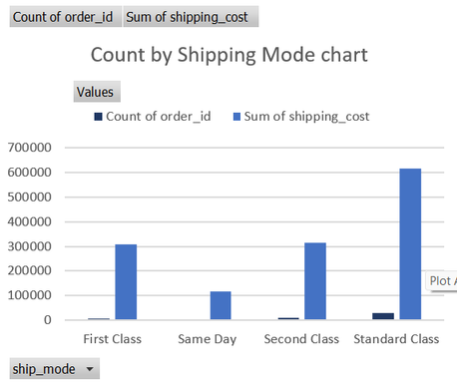
EVALUATING PROFITABILITY AND OPERATIONAL PATTERNS
Chart 8: Profit Margin by Discount Level
Chart used: Scatter chart with lines and markers showing profit margin across discount levels.
Purpose: To examine how profitability varies at different discount levels.
What I learned:
  Transactions with no discount generated approximately 6,992,734 in sales and 1,770,695 in profit.
  The profit margin at zero discount was approximately 25.32%.
  Several high-discount levels recorded negative profit.
  The 70% discount level recorded a loss of approximately 186,350.
Business insight: Some discount levels are associated with weaker or negative profitability. Management should review discount policies and assess whether discounted transactions generate sufficient profit.
Chart 9: Order Count by Priority
Chart used: Column or bar chart comparing order-record counts across priority levels.
Purpose: To understand the distribution of transaction records across order priorities.
What I learned:
  Medium priority: 29,433 records.
  High priority: 15,501 records.
  Critical priority: 3,932 records.
  Low priority: 2,424 records.
Business insight: Understanding order-priority distribution can help evaluate workload and operational planning.
Chart 10: Order Count by Shipping Mode
Chart used: Column or bar chart comparing order-record counts by shipping mode.
Purpose: To compare the use of different shipping services.
What I learned:
  Standard Class: 30,775 records.
  Second Class: 10,309 records.
  First Class: 7,505 records.
  Same Day: 2,701 records.
Business insight: Standard Class accounts for the largest number of records. Shipping costs and delivery requirements should be reviewed together before recommending changes.

Slide 9
KEY LEARNINGS AND BUSINESS RECOMMENDATION
From Data Analysis to Business Decisions
Key Findings
  Sales and profit increased year over year from 2011 to 2014.
  Technology led the product categories in both sales and profit.
  APAC recorded the highest sales and profit among the analyzed markets.
  Consumer was the largest customer segment by sales and profit.
  Certain discount levels were associated with negative profit.
  Standard Class was the most frequently recorded shipping mode.
Recommendations
  Improve product profitability: Investigate subcategories with low or negative profit, particularly Tables.
  Review discount policies: Evaluate whether higher discounts are justified by profitable sales.
  Monitor geographic performance: Compare sales and profit across regions and markets before allocating additional resources.
  Evaluate shipping operations: Review shipping costs, delivery requirements and service levels together.
Challenges and Solutions
  Challenge: Summarizing a large dataset with multiple business dimensions.
  Solution: Used PivotTables and PivotCharts to organize and compare the data.
  Challenge: Making the dashboard interactive.
  Solution: Connected the relevant PivotTables to a Year slicer.
  Challenge: Interpreting sales and profitability together.
  Solution: Compared both measures and calculated profit margin.
Learning Outcomes
  Developed practical Excel data-analysis skills.
  Learned to create KPI summaries and PivotTables.
  Improved chart selection and business-data visualization.
  Learned to interpret trends and identify potential business improvement opportunities.

Slide 10
CONCLUSION
  This beginner-level project provided practical experience in analyzing retail business data using Microsoft Excel.
  By creating KPI calculations, PivotTables, PivotCharts and an interactive dashboard, I learned how to summarize large datasets, compare business performance, and identify patterns in sales, profitability, discounts and operations.
  The analysis highlighted the importance of evaluating profit alongside sales, reviewing discount-related losses, and understanding differences across products, markets, regions and customer segments.
  The project strengthened my ability to convert raw data into meaningful visualizations and practical business recommendations.
Thank You
Nitu Singh
ShadowFox Beginner Data Analytics Internship Project

